Slide 1
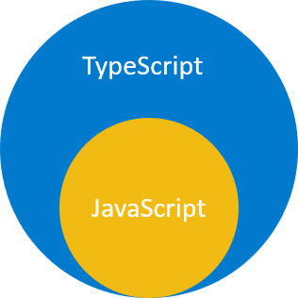
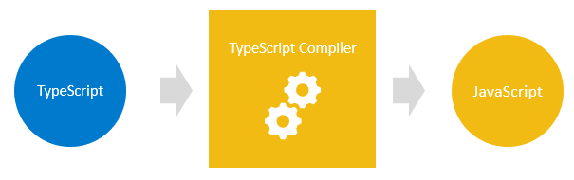
TypeScript
TypeScript is typed JavaScript. TypeScript adds types to JavaScript to help you speed up the development by catching errors before you even run the JavaScript code.
TypeScript is an open-source programming language that builds on top of JavaScript. It works on any web browser, any OS, and any environment that JavaScript runs.
TypeScript files use the .ts extension rather than the .js extension of JavaScript files.
TypeScript builds on top of JavaScript.
TypeScript is a superset of JavaScript.
TypeScript adds type to the JavaScript and helps you avoid potential bugs that occur at runtime.
TypeScript also implements the future features of JavaScript.

Slide 2
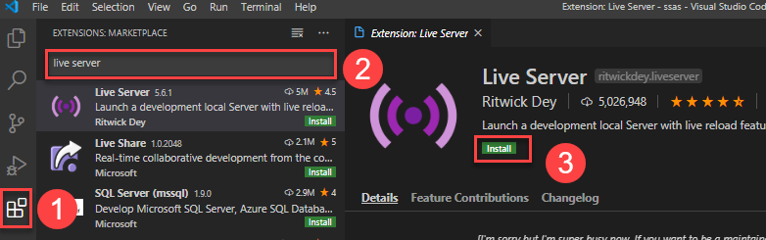
Install Node.js
Go to the Node.js download page.
Install TypeScript compiler
npm install -g typescript
If you’re on Windows and get the following error:
'tsc' is not recognized as an internal or external command, operable program or batch file.
… then you should add the following
path C:\Users\<user>\AppData\Roaming\npm to the PATH variable. Notice that you should change the <user> to your Windows user.
Install tsx module
If you want to run TypeScript code directly on Node.js without precompiling, you can use the tsx module.
To install the tsx module globally, run the following command from the Terminal on macOS and Linux or Command Prompt on Windows:
npm install -g tsx

Slide 3
TypeScript Hello World program in Node.js
First, create a new directory to store the code, e.g., helloworld.
Second, launch VS Code and open that directory.
Third, create a new TypeScript file called app.ts. The extension of a TypeScript file is .ts.
Fourth, type the following source code in the app.ts file:
let message: string = 'Hello, World!';
console.log(message);
Fifth, launch a new Terminal within the VS Code by using the keyboard shortcut Ctrl+` or follow the menu Terminal > New Terminal
tsc app.ts
app.js is generated by the TypeScript compiler:
node app.js

Slide 4
Types in TypeScript
TypeScript inherits the built-in types from JavaScript. TypeScript types are categorized into:
Primitive types.
Object types.
Name | Description
string | Represent text data.
number | Represent numeric values.
boolean | Have true and false values.
null | Have one value: null.
undefined | Have one value: undefined. It is the default value of an uninitialized variable.
symbol | Represent a unique constant value.
Object types
Object types are functions, arrays, classes,

Slide 5
How to declare and initialise Variable in Type Script
let counter: number;
After this, you can only assign a number to the counter variable:
counter = 1;
If you assign a string to the counter variable, you’ll get an error:
let counter: number;
counter = 'Hello'; // compile error
Error:
Type '"Hello"' is not assignable to type 'number’.
You can both use a type annotation for a variable and initialize it in a single statement like this:
let counter: number = 1;
In this example, we use the number annotation for the counter variable and initialize it to one.
let name: string = 'John’;
let age: number = 25;
let active: boolean = true;

Slide 6
Arrays
let names: string[] = ['John', 'Jane', 'Peter', 'David', 'Mary'];
Function arguments & return types
Declaration:
let greeting : (name: string) => string;
In this example, you can assign any function that accepts a string and returns a string to the greeting variable:
greeting = function (name: string) {
return `Hi ${name}`;
};

Slide 7
Likewise, when you assign a function parameter a value, TypeScript infers the type of the parameter to the type of the default value.
For example:
function setCounter(max=100) {
// ...
}
In this example, TypeScript infers the type of the max parameter to be number.
Similarly, TypeScript infers the following return type of the increment() function as number:
function increment(counter: number) {
return counter++;
}
It is the same as:
function increment(counter: number) : number {
return counter++;
}

Slide 8
The best common type algorithm
Consider the following assignment:
let items = [1, 2, 3, null];
To infer the type of items variable, TypeScript needs to consider the type of each element in the array.
It uses the best common type algorithm to analyse each candidate type and select the type that is compatible with all other candidates.
In this case, TypeScript selects the number or null array type (number | null []) as the best common type. Note that the | means the OR operator in types.
If you add a string to the items array, TypeScript will infer the type for the items as an array of numbers and strings: (number | string)[]
let items = [1, 2, 3, 'Cheese'];

Slide 9
Type inference vs. Type annotations
The following shows the difference between type inference and type annotations:
So, when do you use type inference and type annotations?
In practice, you should always use the type inference as much as possible. You use the type annotation in the following cases:
When you declare a variable and assign it a value later.
When you want a variable that can’t be inferred.
When a function returns the any type, you need to clarify the value.
Type inference | Type annotations
TypeScript guesses the type | You explicitly tell TypeScript the type

